Slide 1

UML Tool Assessment EcclipseUML and PowerDesigner
Ranadheer Errabelly, Bhavana Ganne,
College of Science and Engineering
University of Houston – Clear Lake
{errabelly,}@uhcl.edu

Slide 2
Agenda
Introduction-EclipseUML (Omondo)
Repository Support
Roundtrip engineering
Documentation
Data model integration
Model navigation
Printing support
Diagram views
Robustness
Releases
References

Slide 3
Introduction – EclipseUML
Omondo was founded by a team of marketing professionals and java developers.
EclipseUML Free Edition, was launched on September 22nd, 2002.
It was built on the top of the UML metamodel created by Novosoft for UML 1.4 and xmi 1.3.
Omondo partners with Eclipse, OMG and IBM for providing the software solutions for business needs.

Slide 4
Repository Support
EclipseUML consists of an EMF-based implementation of the UMLTM 2.x metamodel for the Eclipse platform. Developers can use the code from uml2 project repository(git://git.eclipse.org/gitroot/uml2/org.eclipse.uml2.git) to experiment, test, build, create patches, issue pull requests, etc. There is a proper versioning done every year.

Slide 5
Round-Trip Engineering
UML to Java, Java to UML UML to C#, C# to UML UML to PHP, PHP to UML UML to C++, C++ to UML It uses a common XMI schema to facilitate interchange of semantic models, test cases etc.

Slide 6
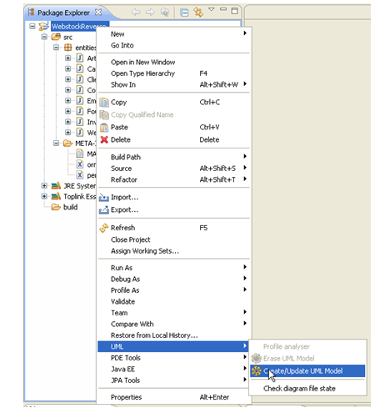
Example of java to UML
Click on your JPA project in your Package Explorer > UML > Create/Update UML Model

Slide 7
Documentation
EclipseUML has the documentation generation feature which can be accessed from the menu bar.
It provides scope for generating documentation either for the selected elements or for the whole project.
It also provides various templates for document generation. The document generated has HTML pages of packages, diagrams and classes.

Slide 8
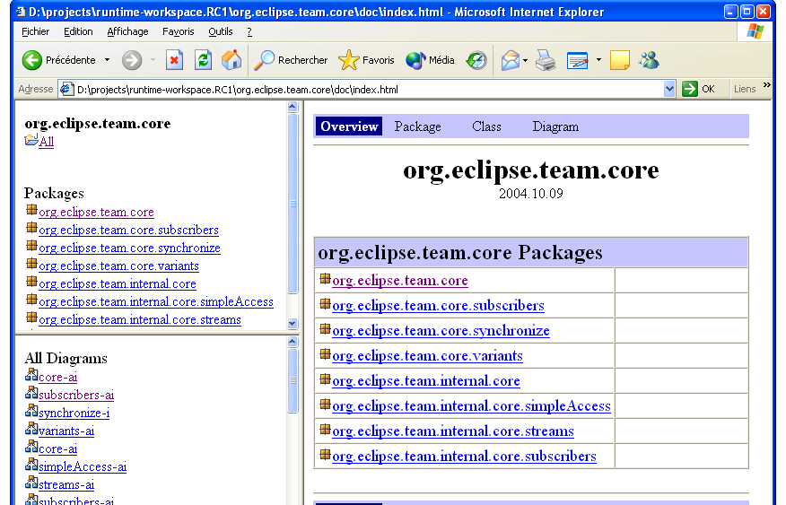
Sample generated Documentation
http://www.uml2.org/documentation_eclipseuml_2008/docgen/launching.html

Slide 9
Data Modeling Integration
To reverse an existing Database into the Class diagram you need to use EclipseUML plug-in. It is not possible to reverse an existing database if you don't use the EclipseUML JEE build including Eclipse 3.3 Europa.

Slide 10
Model Navigation
You can use the Omondo modeling perspective or use any Omondo views inside another perspective like Java, web services etc.

Slide 11
Printing Support
Both EclipseUML free edition and studio edition offers the users print function.

Slide 12
Diagram Views
EclipseUML contains feature to highly customize and view the diagrams clearly.
The view selector allows the class to be viewed in customized format.

Slide 13
Exporting Diagrams
EclipseUML supports Graphical Export Functions. The diagrams are saved in ‘.ucd’ format by default. The diagrams can be exported as SVG, Window Metafile, JPEG, and CompueServe Graphics Interchange.

Slide 14
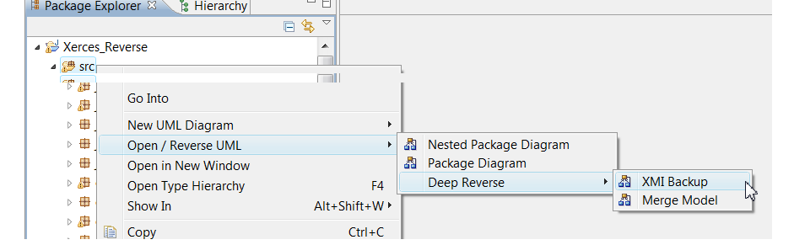
Robustness
The XMI Backup menu is available in the Package Explorer by selecting src > Open / Reverse UML > Deep Reverse > XMI Backup.
http://www.uml2.org/documentation_eclipseuml_2008/reverse/reverse/index.html

Slide 15
New Releases
EclipseUML 2.2 was launched in August 2009. It is built on the top of EclipseUML2 xmi 2.2 metamodel. It is now a native JDT and metamodel integration which is a live three-directional tool .
EclipseUML 2012 Studio Edition was launched on May 2011 for Eclipse 3.7. Stable build for Eclipse 3.7.1 Indigo released January 2012. (current)

Slide 16
References
http://www.uml2.org/
http://www.uml2.org/documentation_eclipseuml_2008/index.html
https://projects.eclipse.org/projects/modeling.mdt.uml2/developer
https://technology.amis.nl/2004/11/04/evalutation-omondo-a-hrefhttpwwwomondocomdownloadfreeindexhtmleclipseuml-free-editiona

